Slide 1
Pose Estimation
Group 4
Devesh Datwani
Thabsheer Machingal
Nitant Vyas

Slide 2
Desired Outcomes
Learn about Convolutional Neural Networks
Learn how to implement a paper on CNN
Learn Pose Estimation

Slide 3
Objective
Input
Output

Slide 4
Why Pose Estimation?
Track athlete performance / postures
Agent intention prediction for autonomous vehicles
Human health evaluation
Video games

Slide 5
Methodology
Machine Learning Technique = Convolution Neural Network (with a regressor)
Neural Network Libraries = Tensorflow, Keras
Dataset = FLIC Pose Dataset
Dataset Size ~ 5003 images (train)
Training Tool = Google Colab notebook that runs a virtual Nvidia K80 / T4 GPU

Slide 6
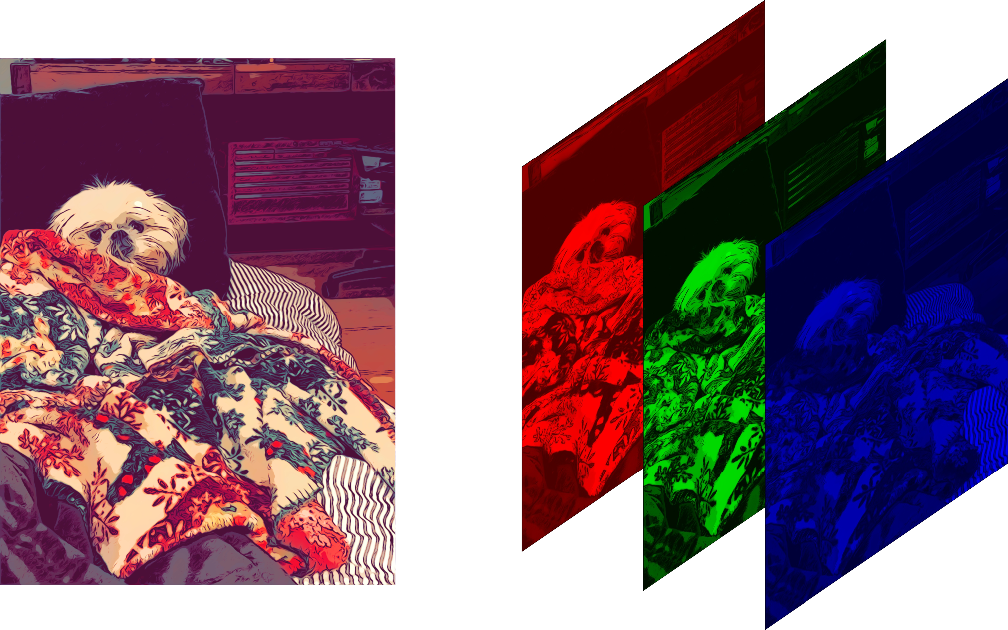
How Is An Image Represented Digitally?

Slide 7
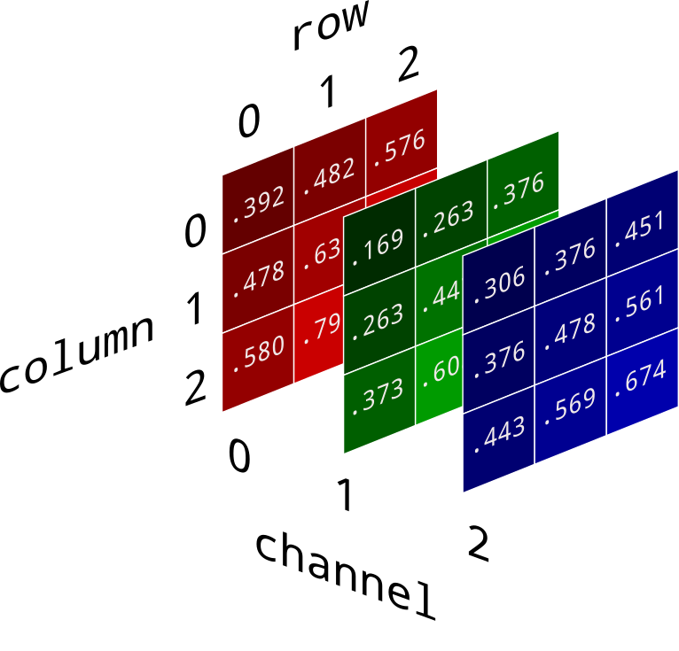
So What’s Inside These “Channels”?

Slide 8
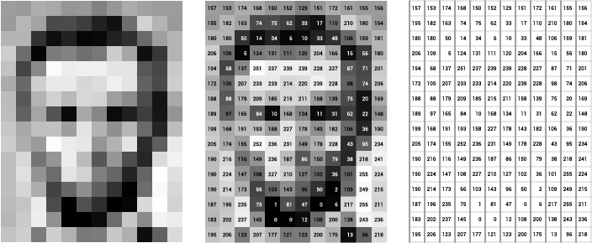
Grayscale Images

Slide 9
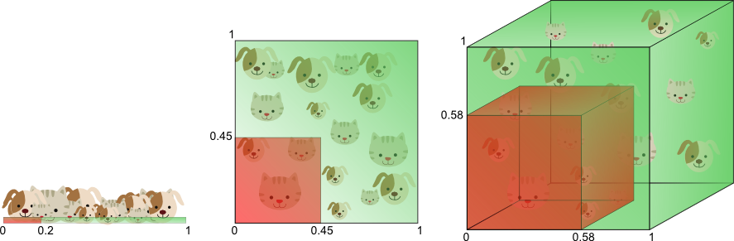
Why CNNs? “Curse of Dimensionality”

Slide 10
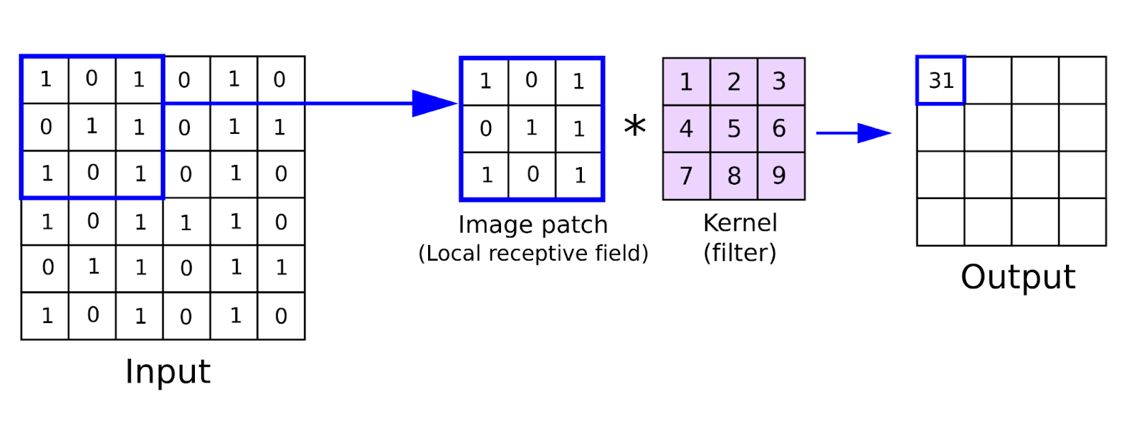
So What Is A Convolution?

Slide 11

Adding Non-Linearity By Adding Activation Function

Slide 12


A Convolution And MaxPool Execution In Action

Slide 13
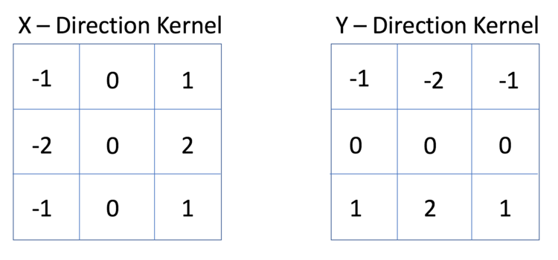
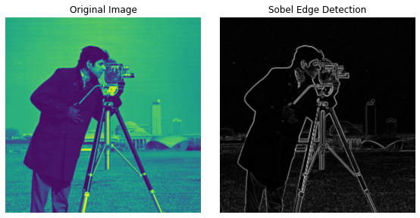
Kernel And Its Output

Slide 14

A CNN Architecture And Training

Slide 15
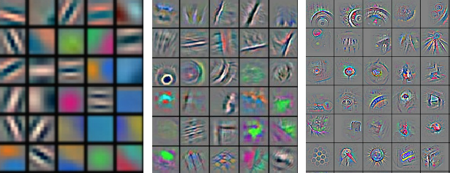
Filters After Training

Slide 16
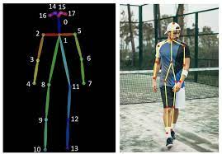
Dataset For Pose Estimation

Slide 17
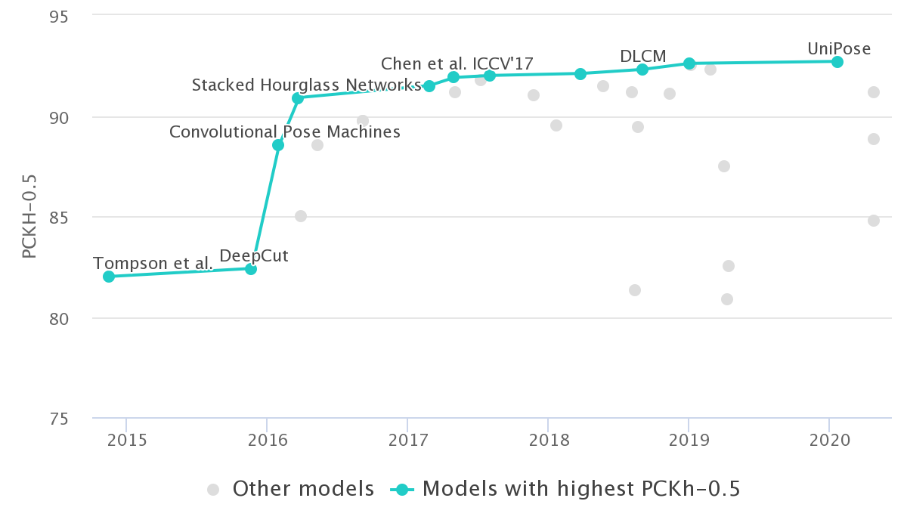
Human Pose Estimation Benchmark (PCKH-0.5)

Slide 18
The FLIC Dataset
5003 annotated images with human beings in stills from Hollywood movies
Image dimension 720 pixels x 480 pixels (color image)
29 key points
Keypoint representation
[ (x1,y1), (x2,y2) ……. (xn, yn) ]^{T}
[ (120, 300), (293, 34), (-1, -1) ……. (400, 600) ]^{T}

Slide 19
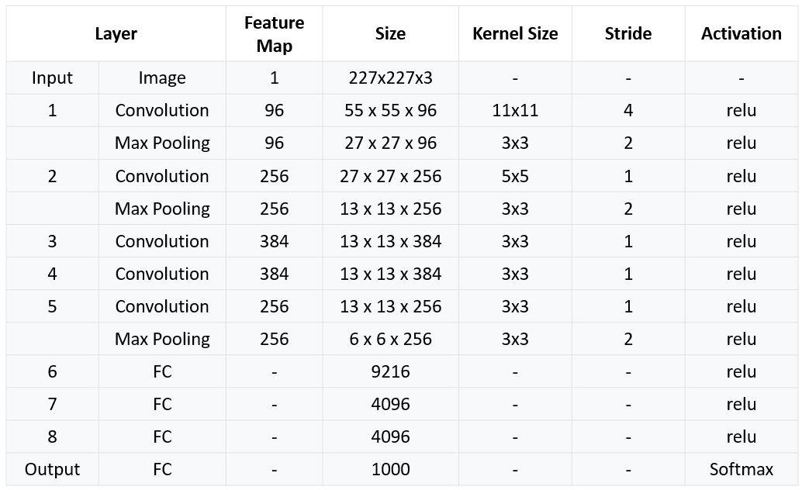
Stage 1 - AlexNet 1.0

Slide 20
x₁
x₂
x₃
x₄
x₅
x₆
.
.
.
.
.
.
.
.
y₂₆
y₂₇
y₂₈
y₂₉
F
C
OUTPUT LAYER
Image
Hidden Layers

Slide 21
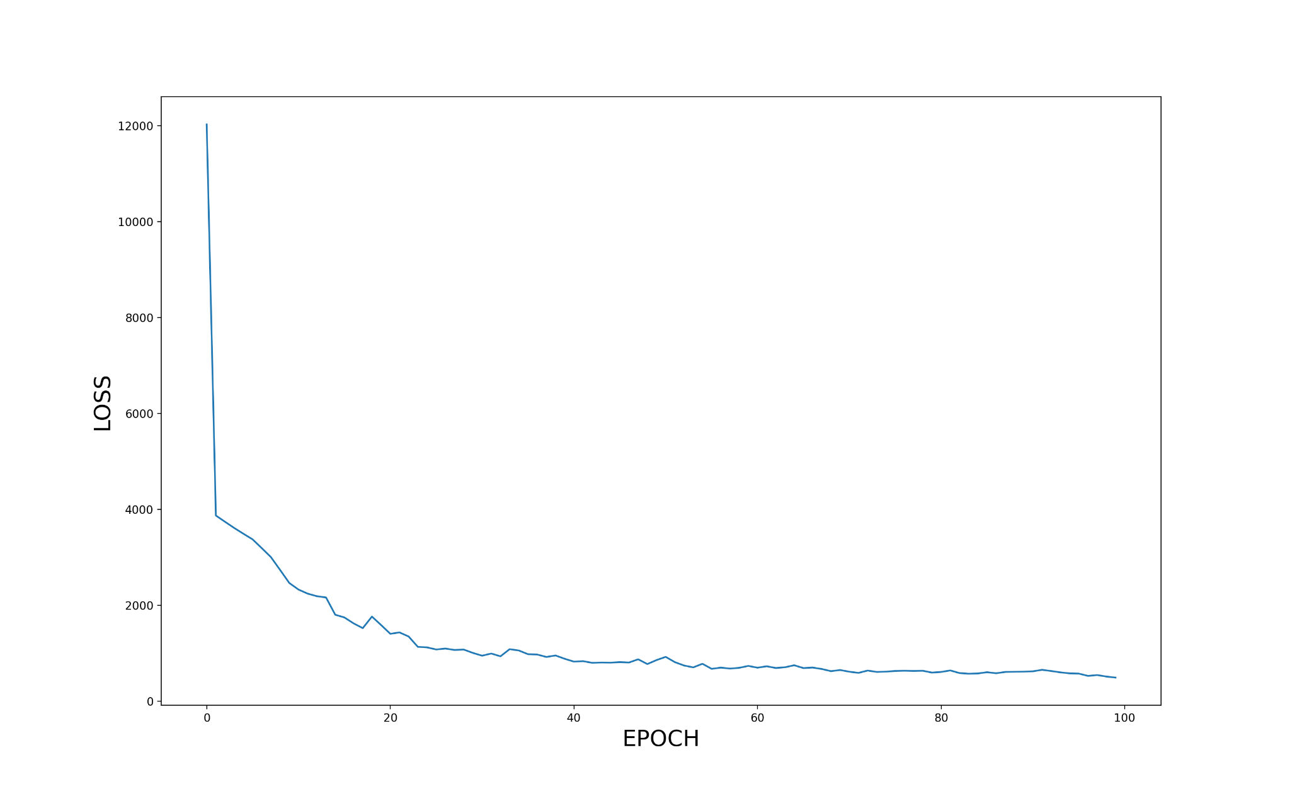
Stage 1 Training Results

Slide 22
Sample Predictions

Slide 23
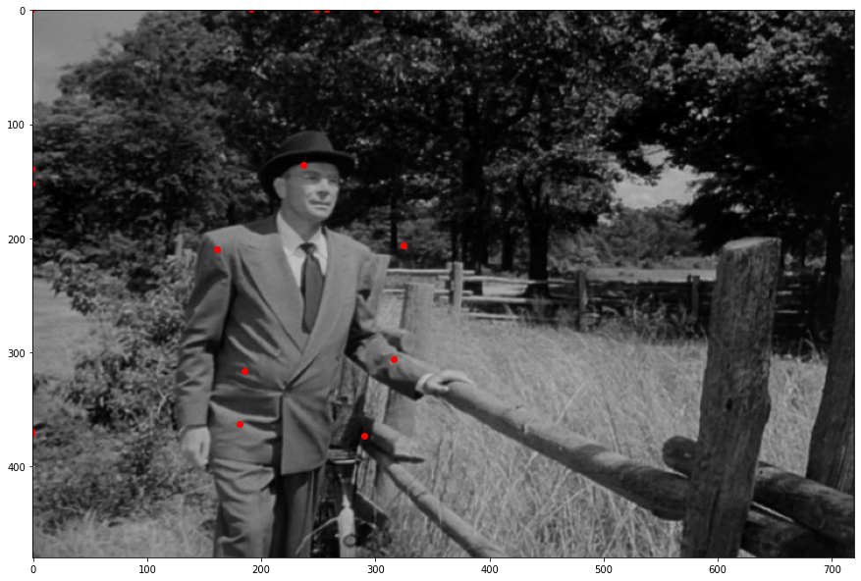

Slide 24
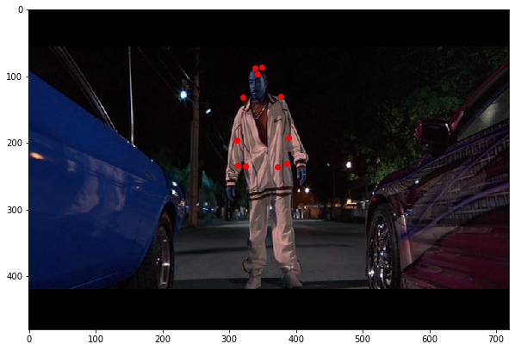

Slide 25
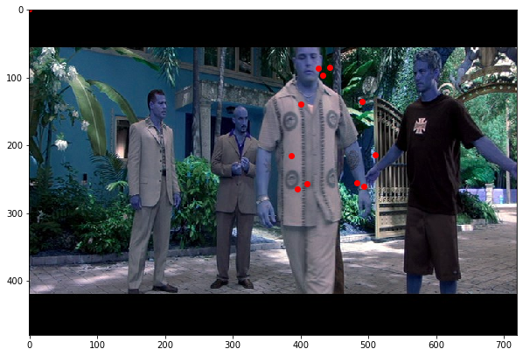

Slide 26
Performance For Stage 1
Intel i5 12th generation Asus ultrabook
No GPU
~ 0.086 seconds for a forward pass
~ 11 frames per second

